Slide 1
Week 12
COMP10001

Slide 2
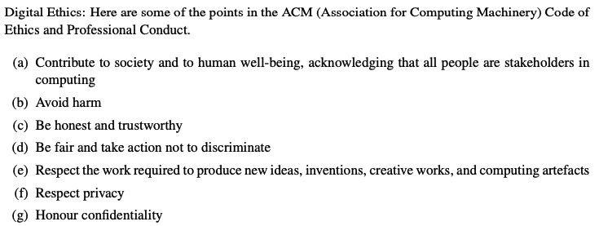

Slide 3
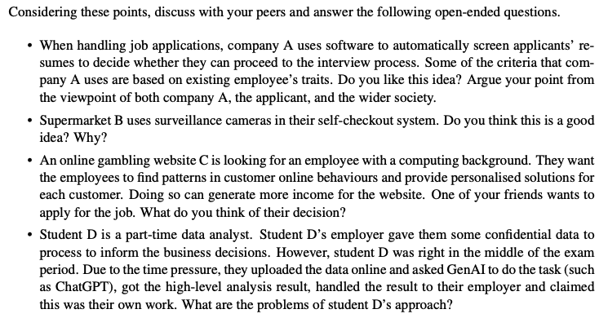

Slide 7
What are the two criteria with which we can judge algorithms?
Correctness
Efficiency

Slide 8
What are the two criteria with which we can judge algorithms?
Correctness
Does the algorithm give the correct output?
Efficiency
How “good” is the algorithm?
Speed, storage, processing power, etc.
We haven’t looked at this in COMP10001! But it’s important to think about as you learn more about algorithms

Slide 9
What are the two criteria with which we can judge algorithms?
Correctness
Does the algorithm give the correct output?
Efficiency
How “good” is the algorithm?
Speed, storage, processing power, etc.
We haven’t looked at this in COMP10001! But it’s important to think about as you learn more about algorithms
Which would you prefer? An algorithm guaranteed to calculate the correct answer that takes 150 years to finish, or an algorithm that takes seconds but may not always produce the correct result

Slide 10
What is the difference between exact and approximate approaches to algorithm design? Why might an approximate approach be necessary?

Slide 11
What is the difference between exact and approximate approaches to algorithm design? Why might an approximate approach be necessary?
Exact approach: gives correct solution
Approximate approach: gives almost the correct solution, through estimation, simulation, etc.

Slide 12
What is the difference between exact and approximate approaches to algorithm design? Why might an approximate approach be necessary?
Exact approach: gives correct solution
Approximate approach: gives almost the correct solution, through estimation, simulation, etc.
If a problem is too complex to calculate with full completeness, an approximate approach might be more useful!

Slide 13
Some popular categories of algorithm
Brute force (generate and test)
Exact. Finds every possible answer and tests it. Requires set of possible answers to be finite to guarantee completion. E.g. linear search
Heuristic search
Approximate. E.g. finding the shortest path to a destination. Finding the definitive solution would require processing many possibilities - we can find an approximate search very quickly. (Ranks alternatives to prioritise possible paths to look at first) May find the exact solution!
Simulation
Approximate. Finds a solution by generating lots of data to predict an overall trend. E.g. simulate play of a game to find out if it’s worth playing
Divide and conquer
Exact. Divides problem into sub-problems which can be more easily solved. E.g. binary search

Slide 14
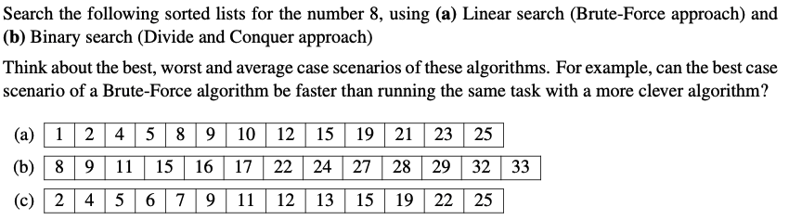

Slide 16
What is HTML? What’s it used for?

Slide 17
What is HTML? What’s it used for?
HyperText Markup Language
A markup language (as opposed to a programming language)

Slide 18
What is HTML? What’s it used for?
HyperText Markup Language
A markup language (as opposed to a programming language)
Takes a document composed of text and other media and communicates how it should be rendered for display

Slide 19
What is HTML? What’s it used for?
HyperText Markup Language
A markup language (as opposed to a programming language)
Takes a document composed of text and other media and communicates how it should be rendered for display
E.g. an internet browser displays a webpage by downloading and presenting the website’s HTML

Slide 20
Revise the HTML tags we know!

Slide 21
Revise the HTML tags we know!
Use angle brackets: <open> </close>
<b>, <i>, <u>
<html>
<head>, <body>
<ul>, <ol>, <li>
<table>, <tr>, <td>
<a>, <img>, <audio>, <video>

Slide 22
Entities are special characters!
An entity is a special character, written with &entity; syntax
E.g. &lt; &gt; &nbsp; &amp;

Slide 23
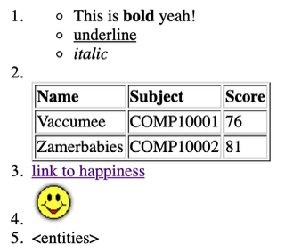
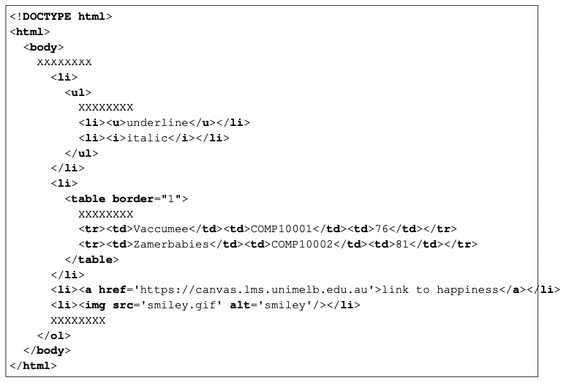
Fill in the blanks!

Slide 24
Fill in the blanks!
<ol>
<li> This is <b>bold</b> yeah! </li>
<tr><th>Name</th><th>Subject</th><th>Score</th></tr>
<li>&lt;entities&gt;</li>

Slide 25
Let’s have a look at some HTML in the wild!

Slide 26
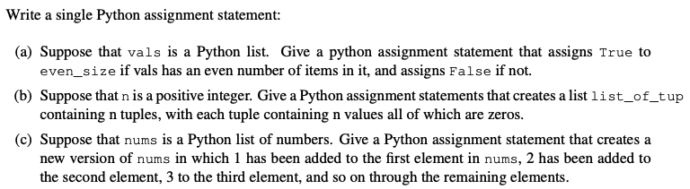
Past exam questions

Slide 27
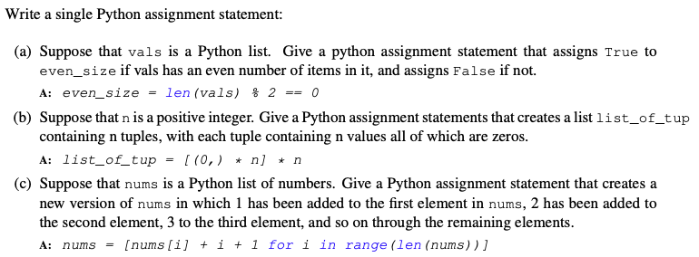
Past exam questions

Slide 28
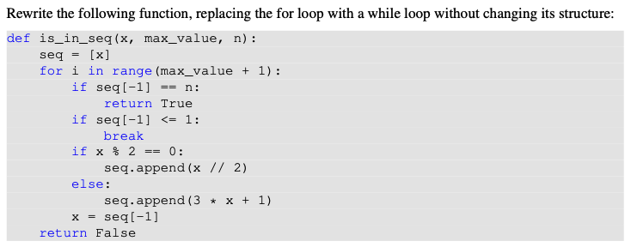
Past exam questions

Slide 29
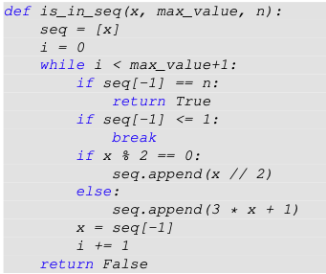
Past exam questions

Slide 30
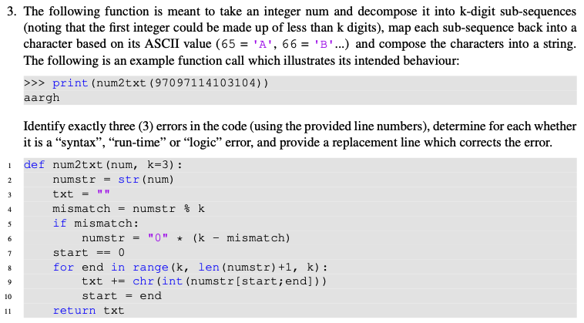
Past exam questions

Slide 31
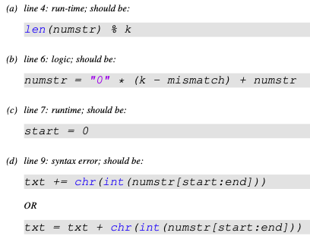
Past exam questions

Slide 32
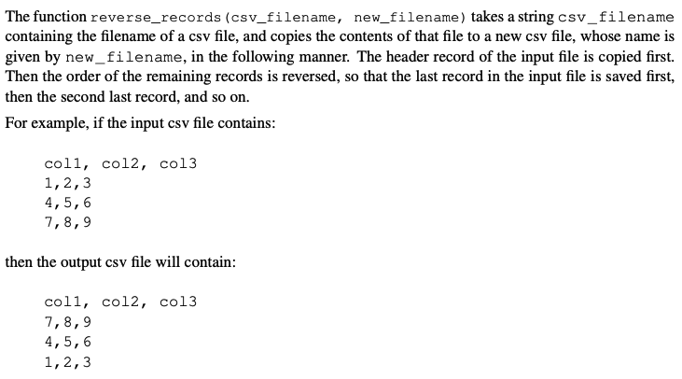
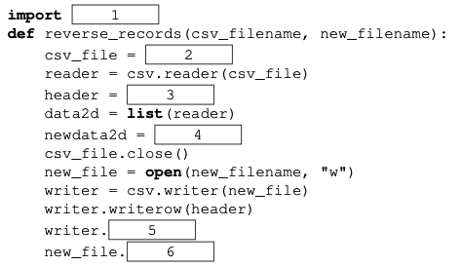
Past exam questions - fill in the blanks

Slide 33
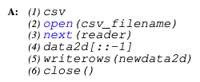
Past exam questions - fill in the blanks

Slide 34
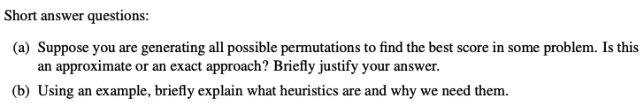

Slide 35
